Slide 1
Cafuné
Team: Bye
Elicia Powell | Yll Ahmeti | Bryan ZM

Slide 2
Pitch
We are in an age with a growing consumption of fast fashion, where buyers can order cheaply made clothing that wears out in days or weeks with just a click of a button. Cafuné encourages customers to invest in themselves by choosing durable, long-lasting handmade wearables. If you’re looking for clothing with quality, care, and a personal touch, Cafuné is for you.

Slide 3
Background
Showcasing and selling handmade crochet products, created in partnership with computer science undergraduate Elicia Powell, to highlight her work and support student makers.
Difficulties small creators face in promoting and selling their crocheted goods online by providing an organized platform.
By emphasizing handmade craft, care instructions, community, and user-friendly shopping features, the project aims to broaden the reach of local artisans and foster stronger engagement between creators and customers.

Slide 4
Solution
We are creating "Cafuné," a dedicated, visually engaging e-commerce website that organizes handmade crochet products by category, highlights new arrivals and seasonal collections, and enhances the shopping experience with features like user accounts, wish lists, and a cart.
The platform stands out by focusing exclusively on our classmate’s curated crochet work.

Slide 5
Project Deliverables
The main product of the team’s project will be a fully functional e-commerce website for handmade crochet products, designed specifically to showcase and sell the items made by our classmate Elicia Powell.
Group Contract: participants with roles and availability
Project Plan: estimated project duration with updated project duration
Project Proposal: written justification of project proposed with criteria success and deliverables information
Site Map: visual documentation of website structure
Requirements Specifications: description of functionality, client and product information, user roles, and technical needs
Design and Pitch: layout for all pages and sections, design rationale, color palettes, and font choices
Development Plan: features assignments, development milestones, and technologies used
Product Testing: details of test cases, methods for functionality, and usability testing
Product Review for client (Elicia Powell): comprehensive document summarizing the project’s process, achievements, and lessons learned

Slide 6
Success Criteria
A homepage that displays a categorized list of products with a filter function.
An account system where customers can create accounts and log in.
Each product displays its price clearly to the user.
A shopping cart where users can add items, view their selections, and see the total cost.
A checkout page where users can enter payment information. It’ll be nonfunctional, but the system will save order details.

Slide 7
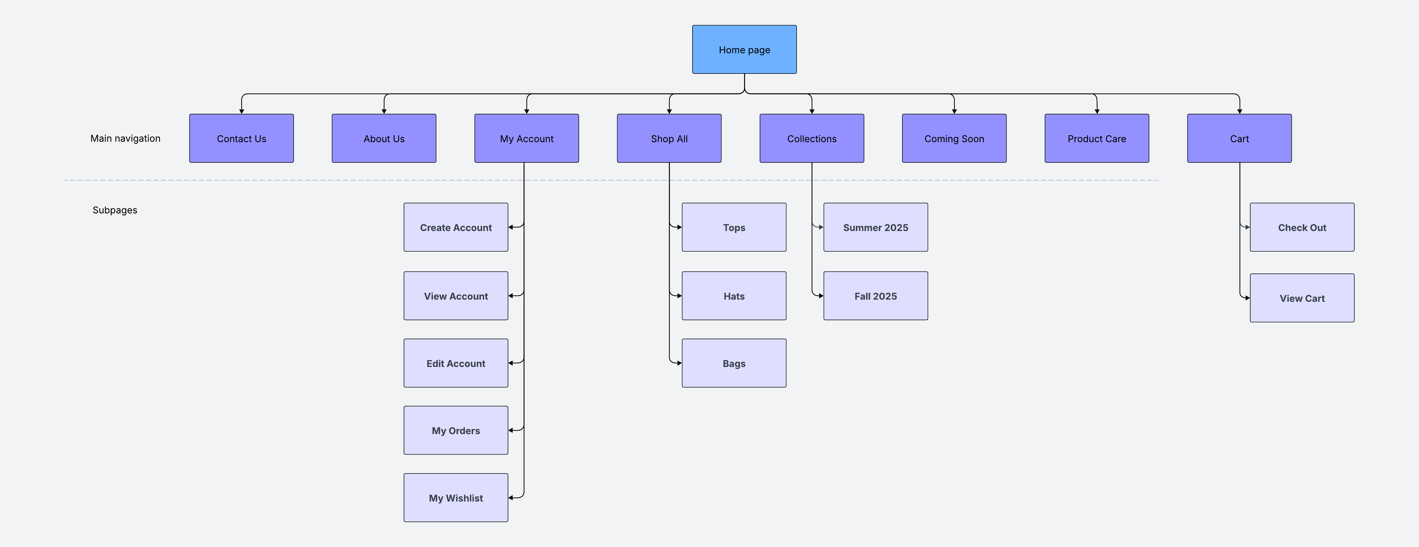
Site Map

Slide 8
Project Planning Document

Slide 9
BYE

